Slide 1
Improving Efficiency for String Similarity Searches through Clustered Pruning
Kyle Patterson, James Fitzpatrick

Slide 2
Original Idea
Comparing VGRAM and Top-K
Build clusters on strings based on LCS
Trim search space by clusters
Compare Naïve VGRAM/Top-K versus trimmed search space

Slide 3
Problems!
Clustering was way too difficult for the time and computing restraints
Tried building an InvertedList based on LCS instead, similar to clustering
List construction was doable, but in the end took
Could be useful for situations with low amounts of memory, but it takes a long ass time to make

Slide 4
String Similarity
Many Different Approaches
Utilize Edit Distance Comparisons
Each operation that leads from string s to query string q increased ED by 1
Insertion
Deletion
Substitution
Top-K and VGRAM both use tries to reduce search space

Slide 5
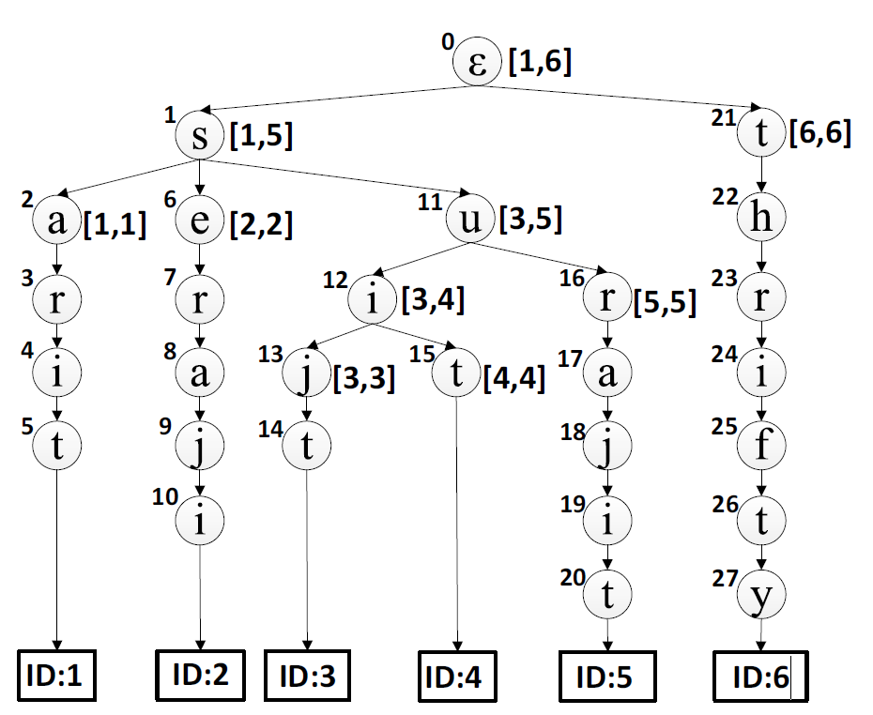
Top-K Concepts
Pivotal Top-K Search
Split each string into individual characters
Add each string to a master trie
Similar prefixed strings descend from same parents
Works well for many short strings that have similar prefixes/suffixes
Experimentally: Does not work well for long, unique strings

Slide 6
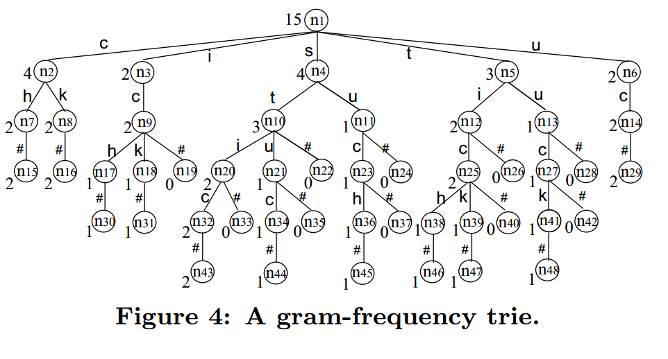
VGRAM Concepts
Divide each string into grams of variable length [min, max]
Associate each string with its VGRAMS
When searching, divide query into its longest length v-grams
Terms that share more v-grams are more similar to q

Slide 7
VGRAM Concepts
Positional VGRAM
Variation on VGRAM
Utilizes positional data to distinguish the VGRAMs more
Location of grams may be a distinguishing feature of datasets
Pruning
Reduce the search space further by removing inconsequential VGRAMS
Reduce long unique VGRAMs to shorter equally significant ones
Remove long and frequent VGRAMs, but keep most unique substrings

Slide 8
Clustering Concepts

Slide 9
Difference Matrix

Slide 10
Initial attempts at clustering

Slide 11
InvertedList concepts

Slide 12
InvertedList Implementation

Slide 13
Experimental Setup
C# to encode both Search Algorithms

Slide 14
Testing and Evaluation

Slide 15
Results

Slide 16
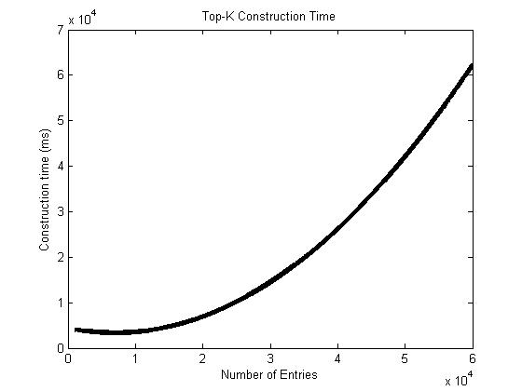
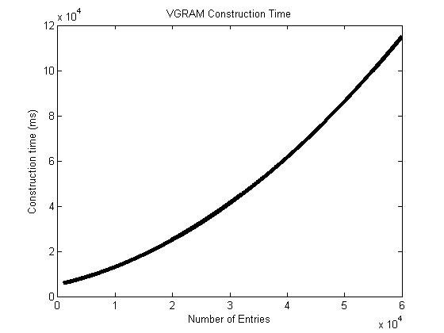
Trie Construction Times

Slide 17
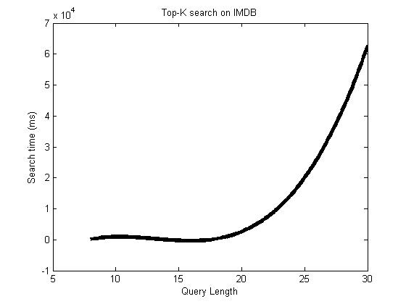
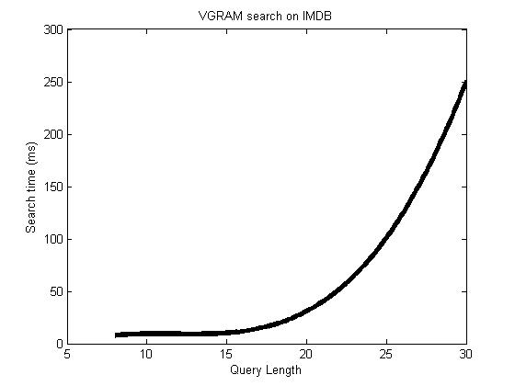
Query Time on IMDB – naïve

Slide 18
Something about pruning with InvertedList

Slide 19
Conclusion
Clustering would probably be great, if it were less computationally expensive
Inverted Lists are also great, but constructing based on LCS is very expensive

